Slide 1
Feedback Tremor
First results
16.05.2021
Julius Welzel

Slide 2


Paradigm
Task
6s “hit & hold” target with thumb & index finger
Archer: 30s “hit & hold” target with whole hand
Manipulations
Visual gain (viewing angle)
Uniformly distributed between 12.9° & 1.3°
Archer: 2 conditions – 0.039° & 6.9°
Max force (MVC)
15, 20 & 25 % of a 3 trial average of 3 seconds
Archer: only 15%
Feedback
Visual, auditory & combined
Archer: only visual
~12.9°
~1.3°

Slide 3
Pipeline force data (vs. Archer ea., 2017)
Raw data
Cut to epochs
Raw data
Find Mean & SD
Cut to epochs
Normalise to MVC & %MVC
Cut to middle 25s period
Extract FFT based bandpower 4-12 Hz
Calculate Error (RMSE)
Sum of power 4-12 Hz (No further information)
Find outliers based on 3 median absolute deviations
High – low visual gain per participant
Zscore per participant

Slide 4
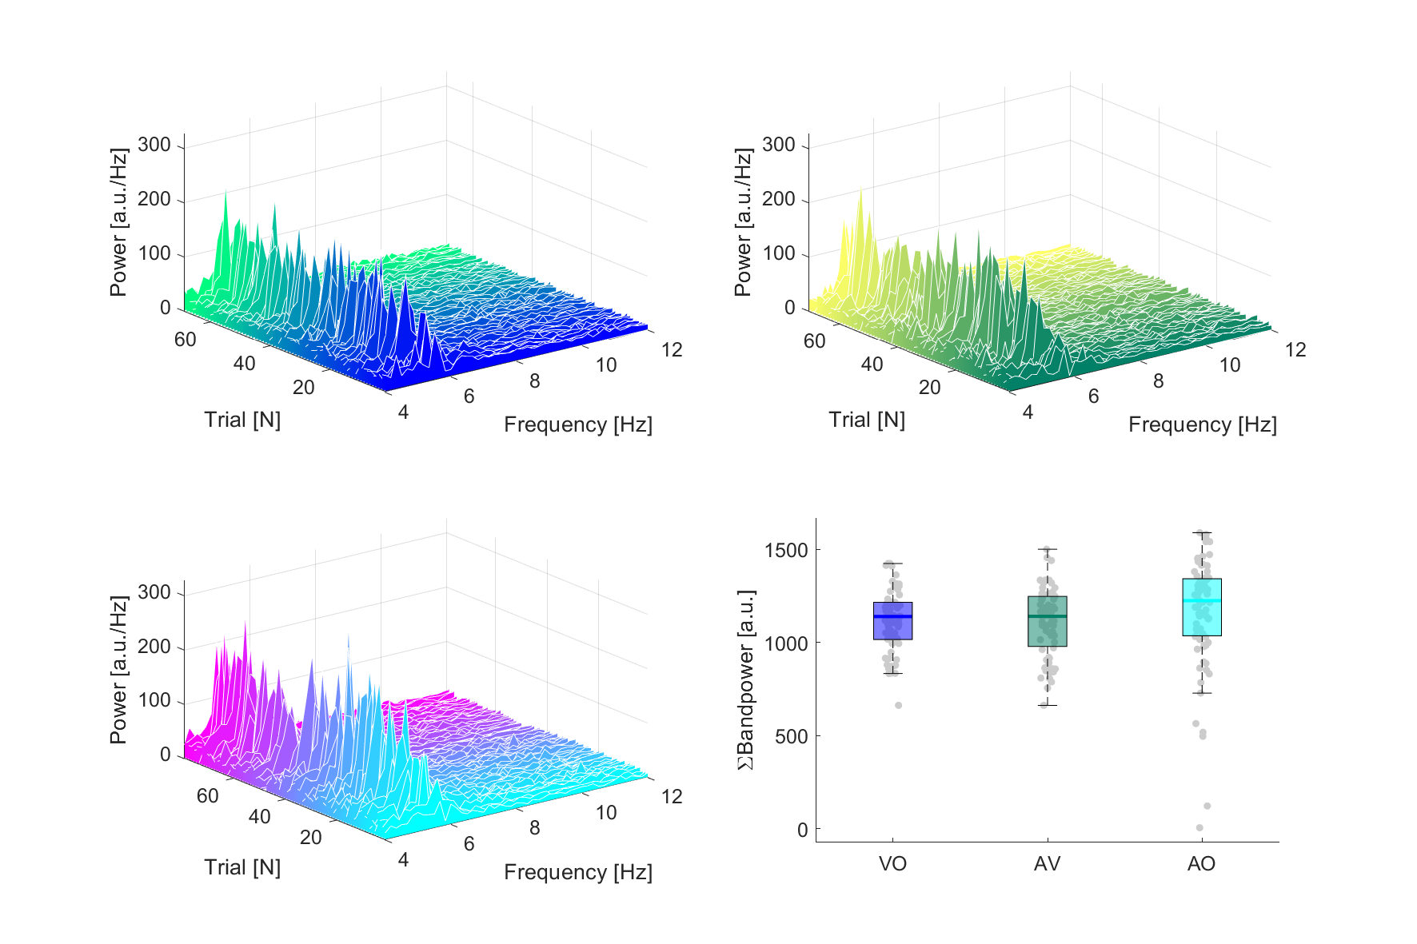
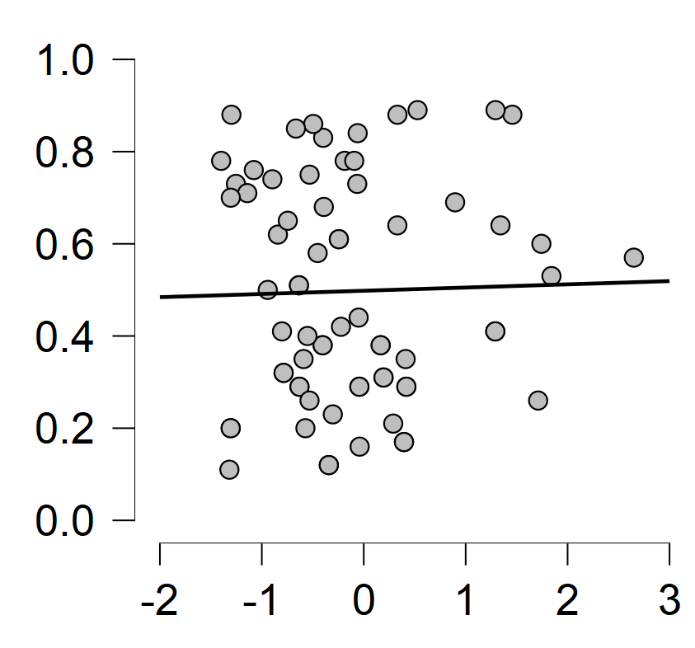
Good tremor data example (p105)
Constant tremor in all trials over all feedback conditions
Higher variance in auditory feedback condition
No correlation (r = .025, p = 0.837) between visual feedback scaling and tremor power
Sclae (Visual Gain)
Z-scored Power_{4-12 Hz}

Slide 5
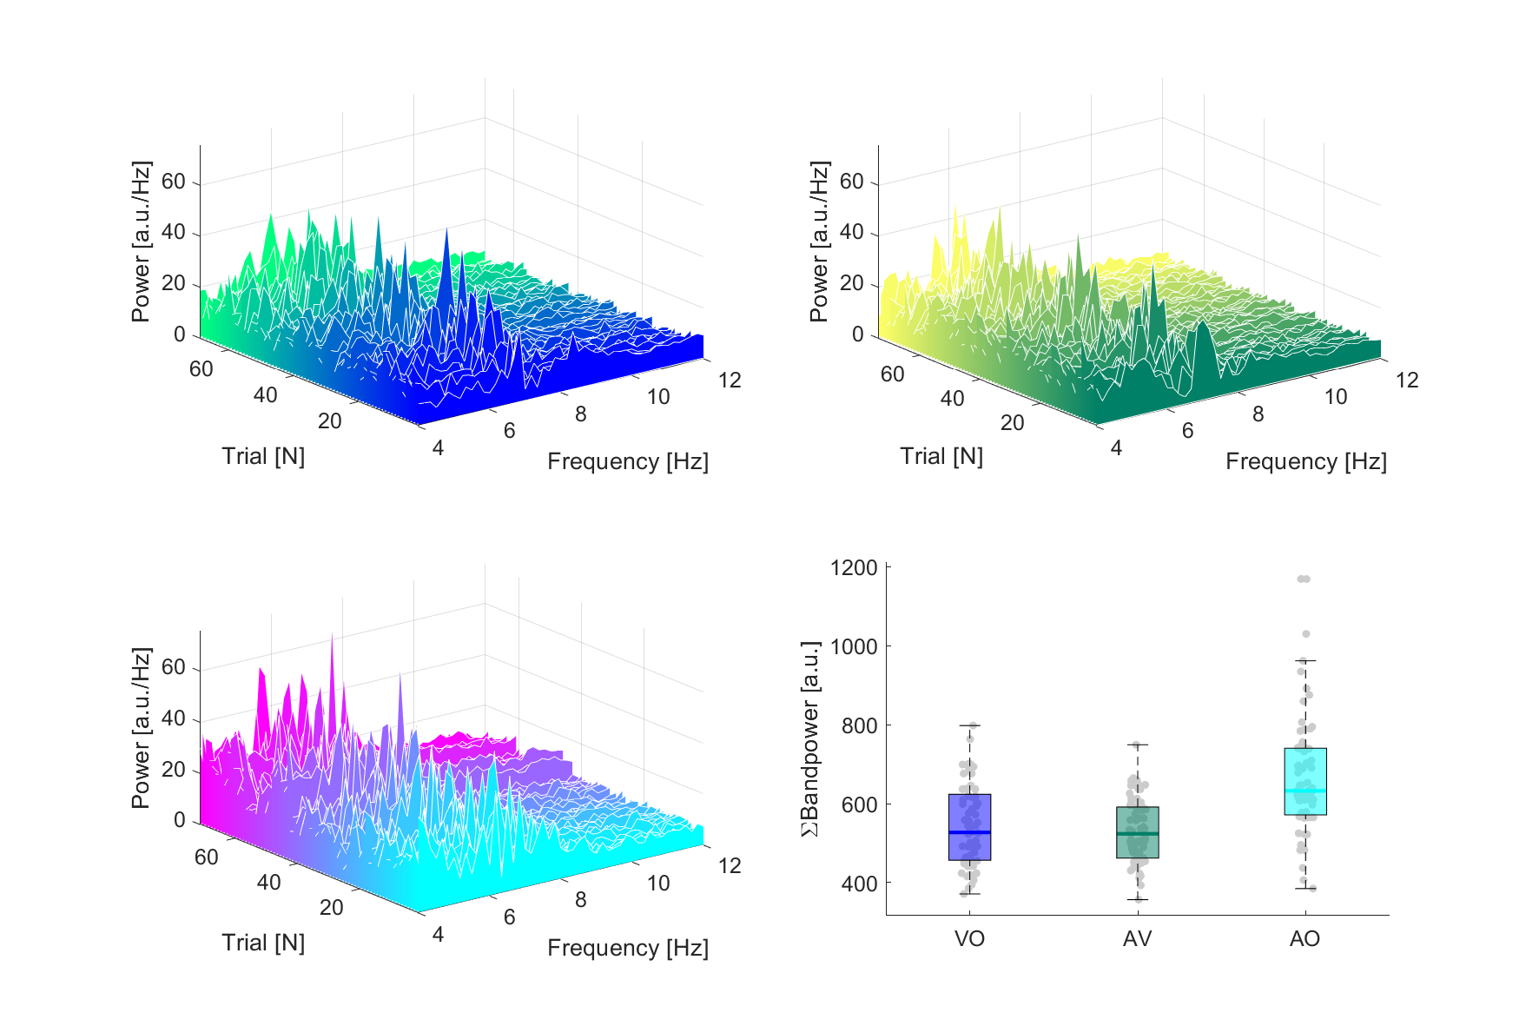
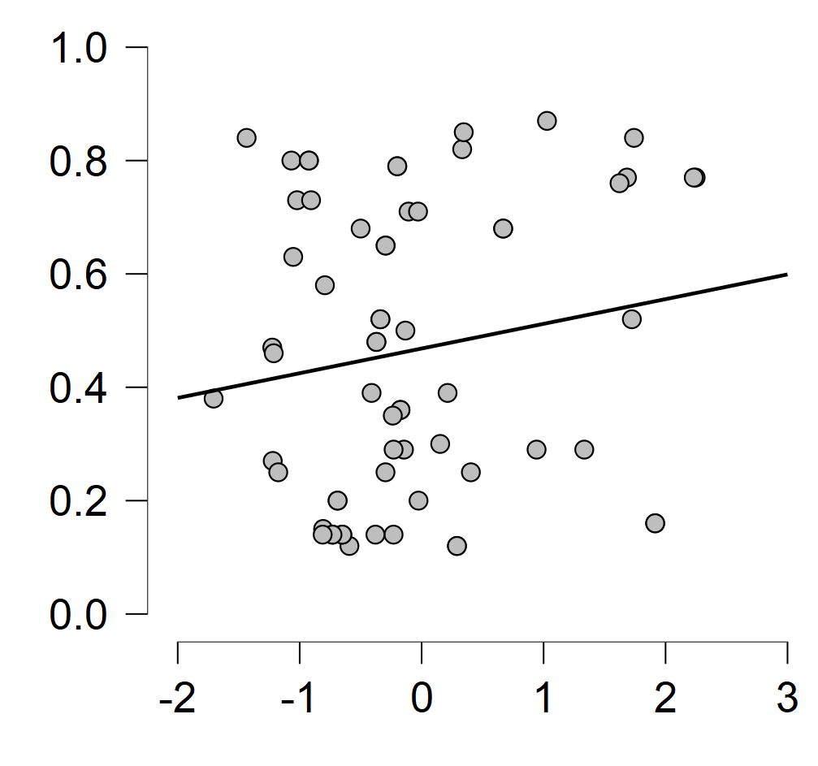
Bad tremor data example (p103)
Constant tremor in all trials over all feedback conditions
Higher variance in auditory feedback condition
No correlation (r = .162, p = 0.200) between visual feedback scaling and tremor power
Sclae (Visual Gain)
Z-scored Power_{4-12 Hz}

Slide 6
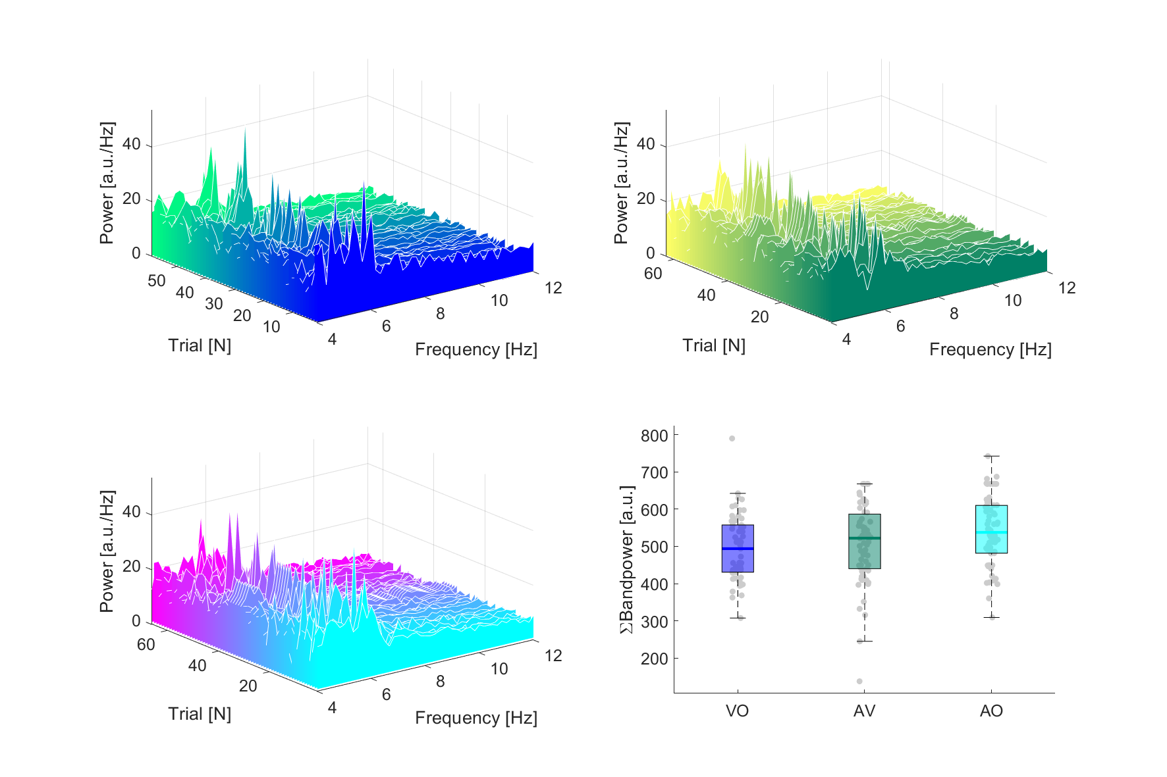
p100

Slide 7
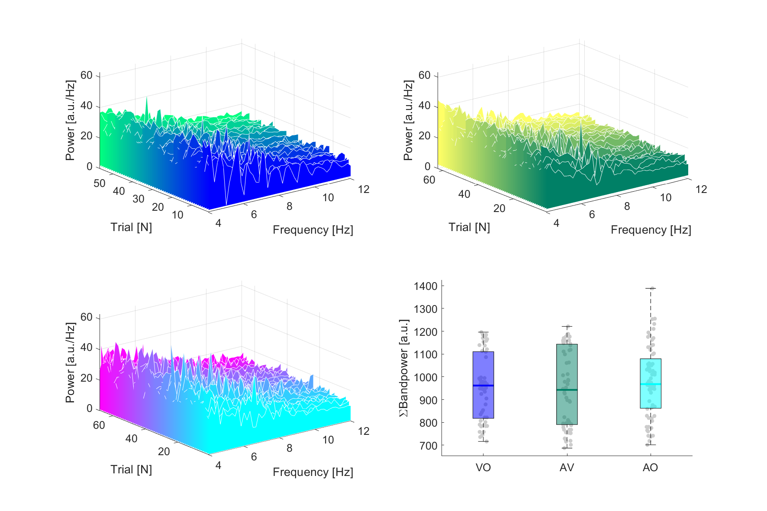
p101

Slide 8
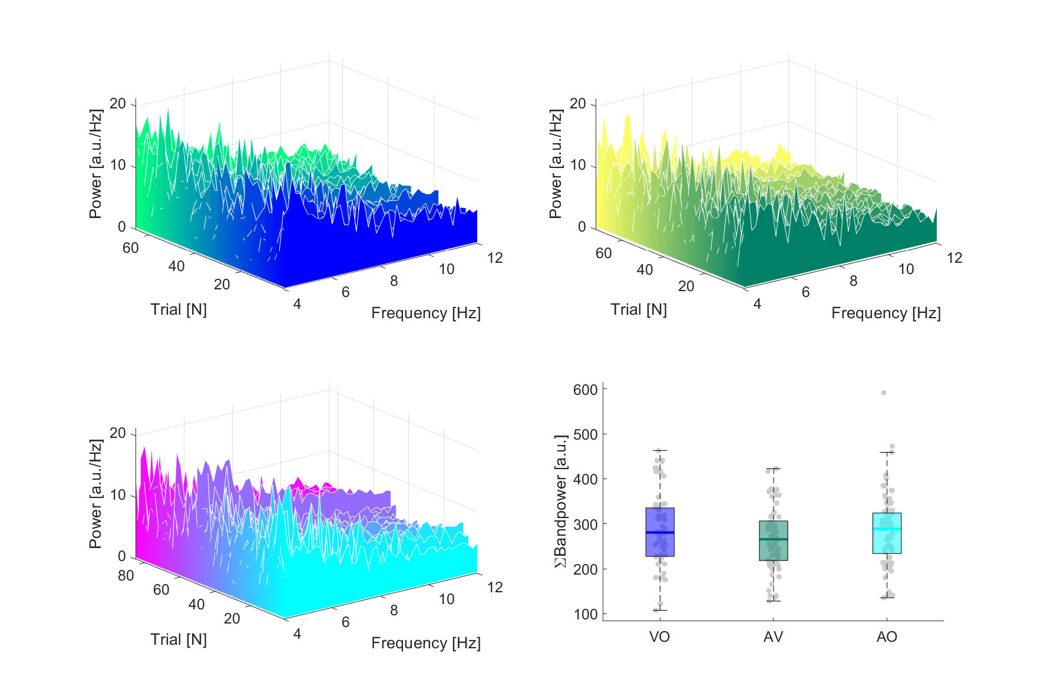
p102

Slide 9
p103

Slide 10
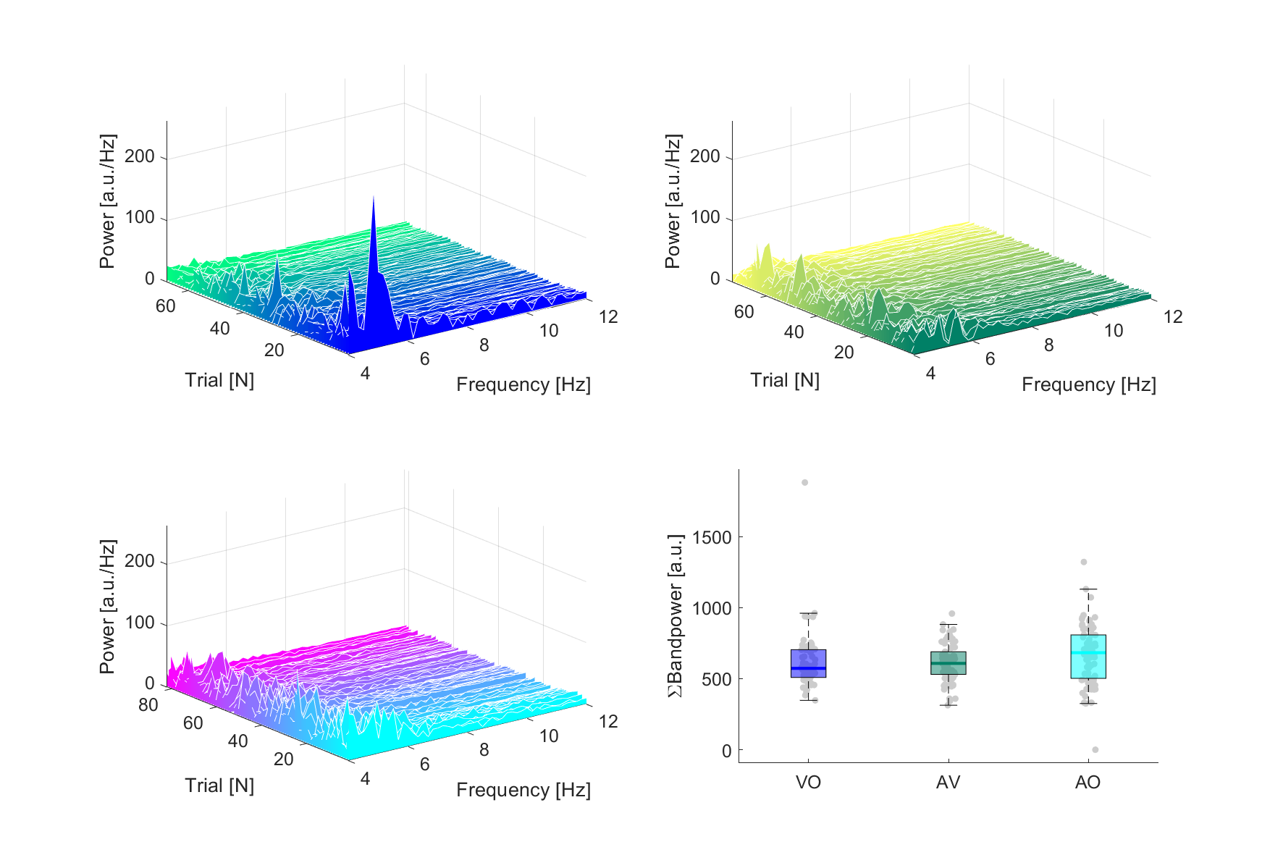
p104

Slide 11
p105

Slide 12
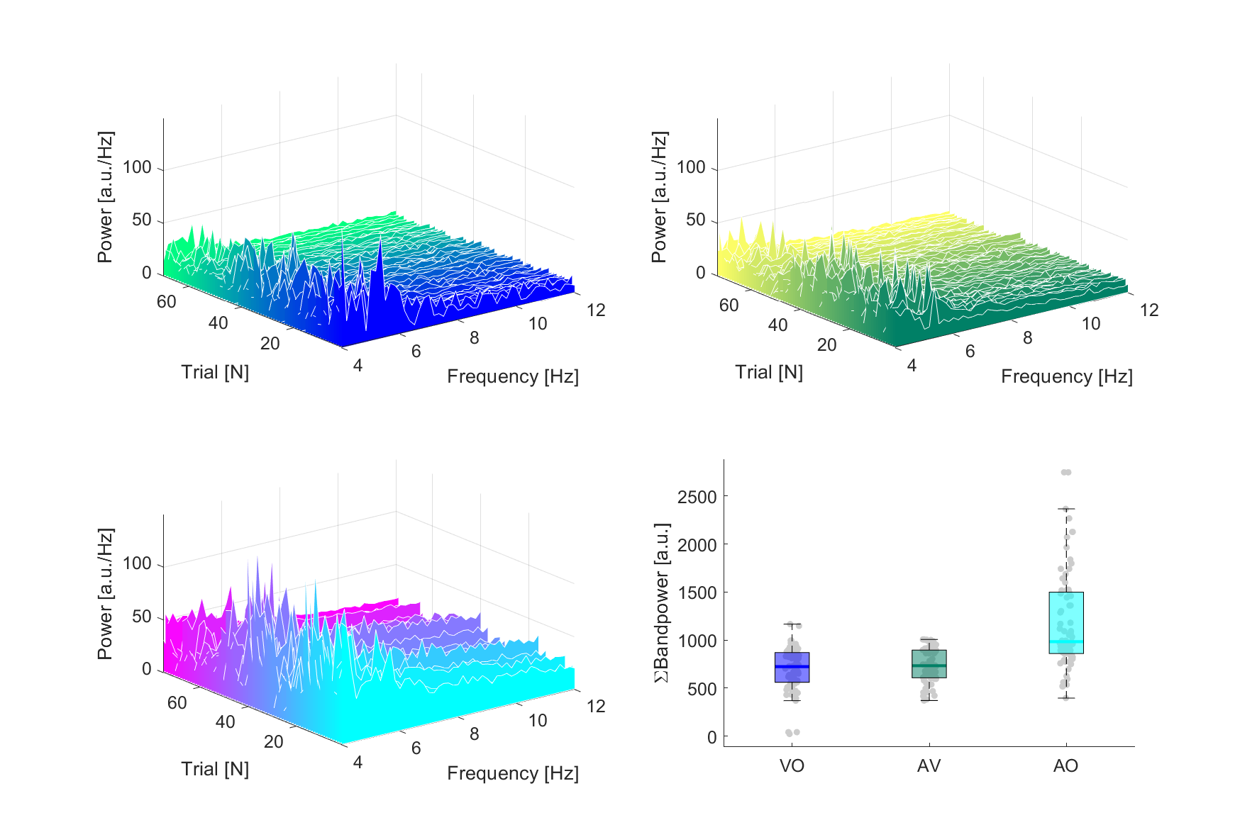
p106

Slide 13
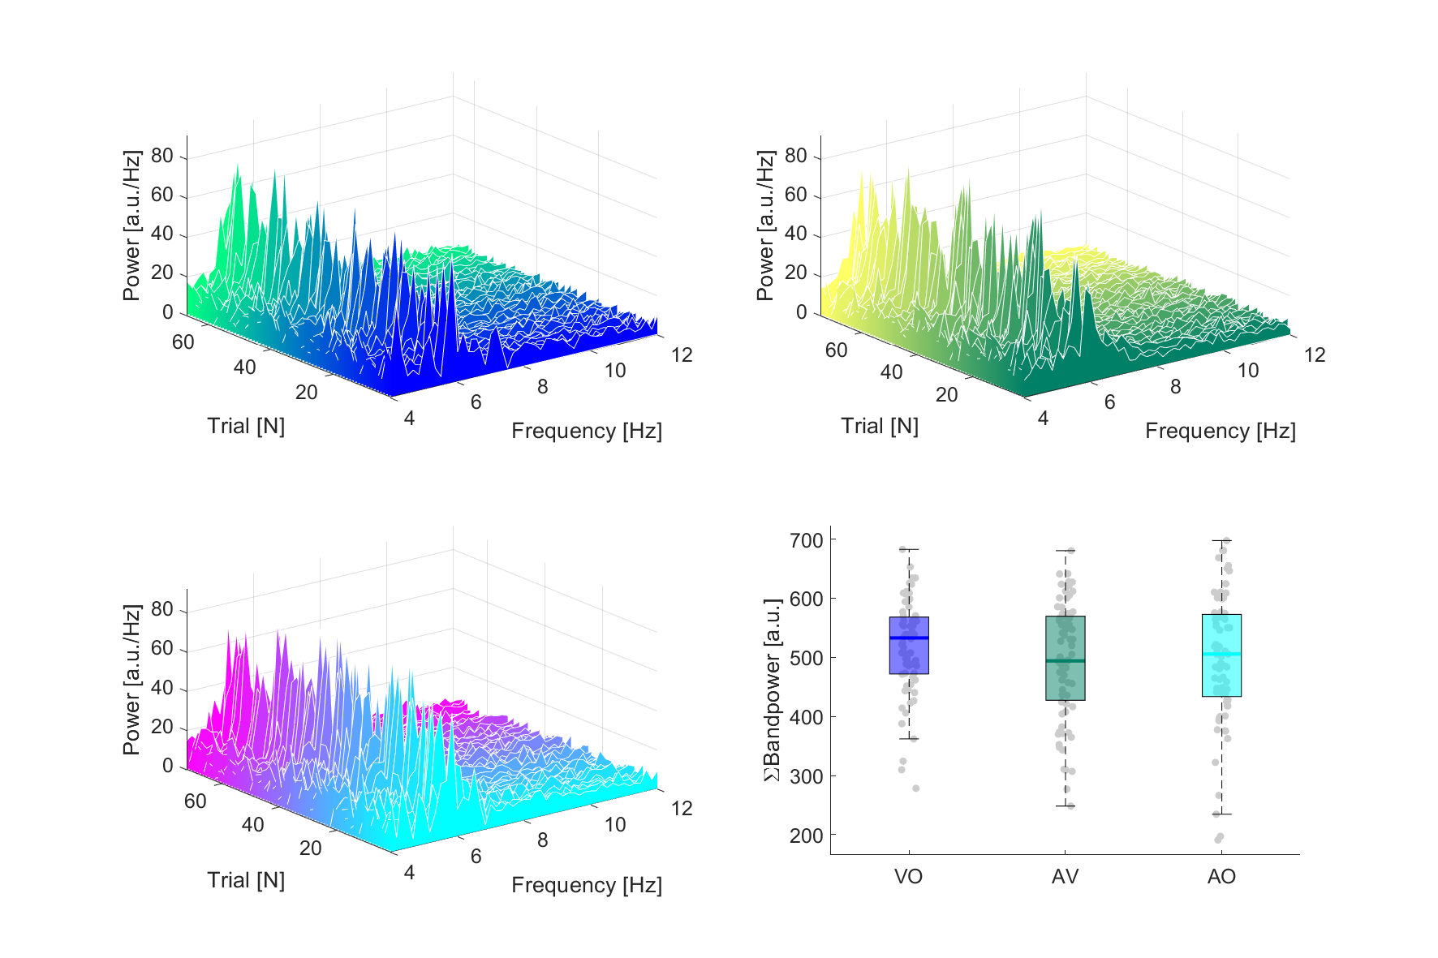
p107

Slide 14
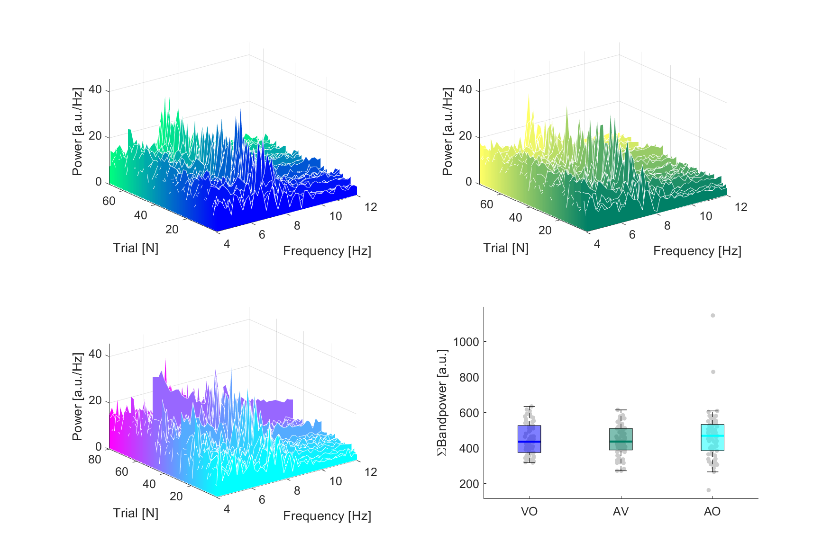
p109

Slide 15
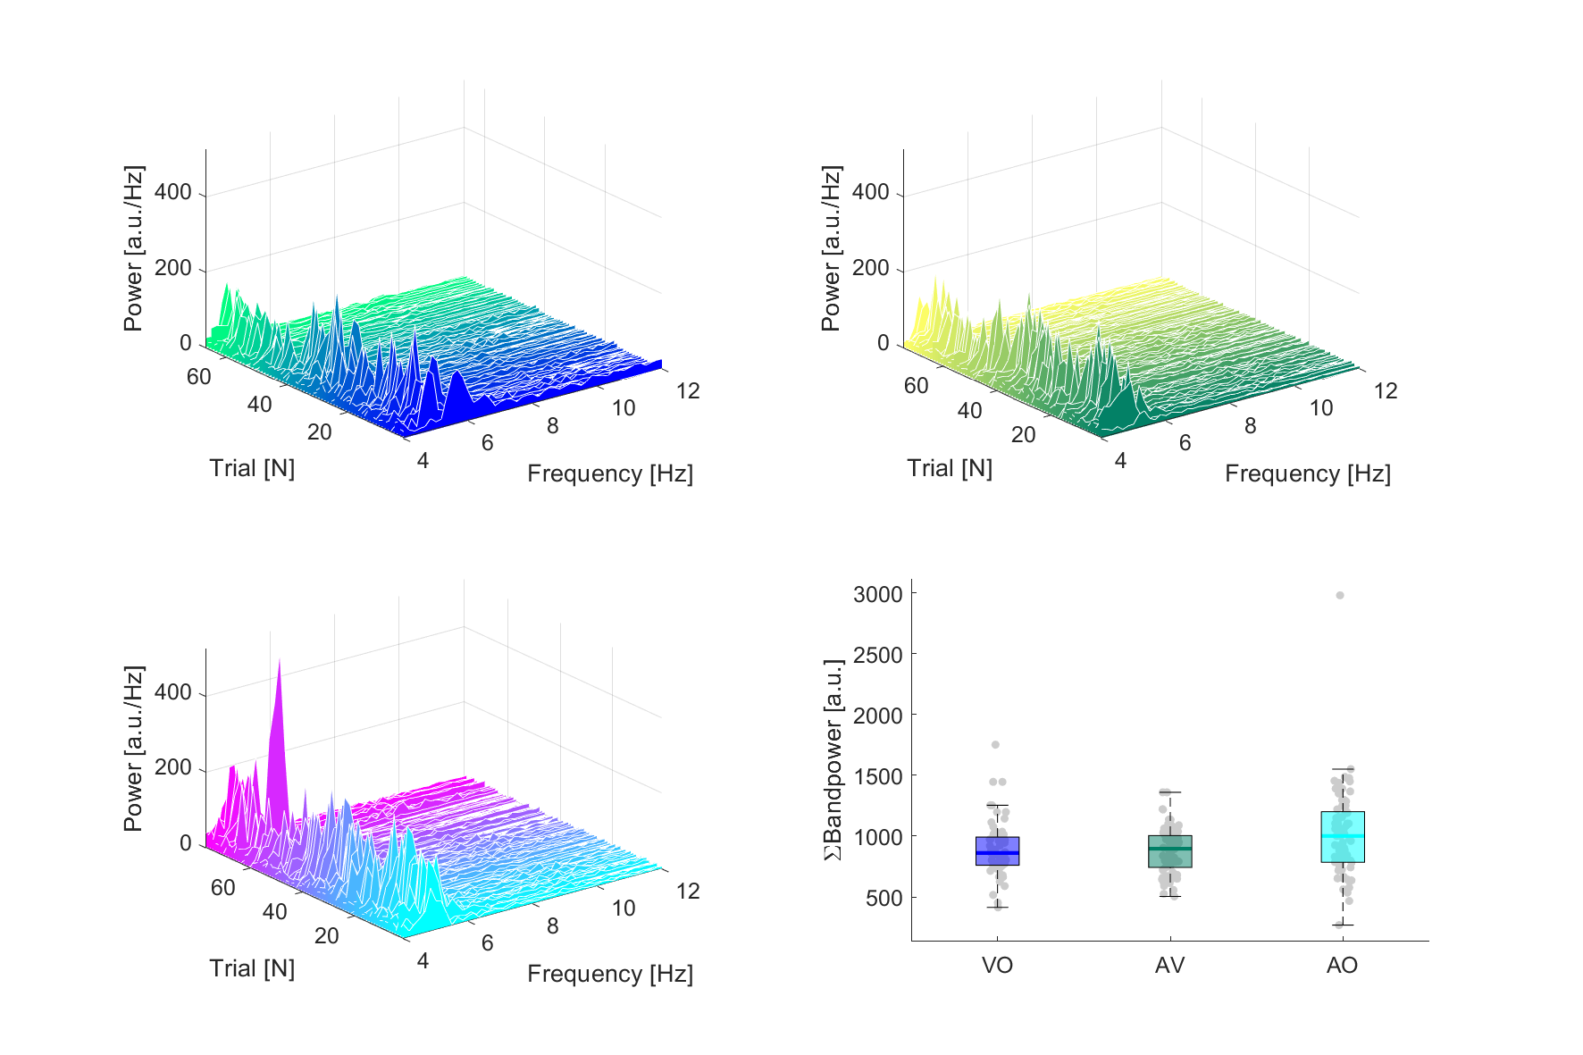
p112

Slide 16
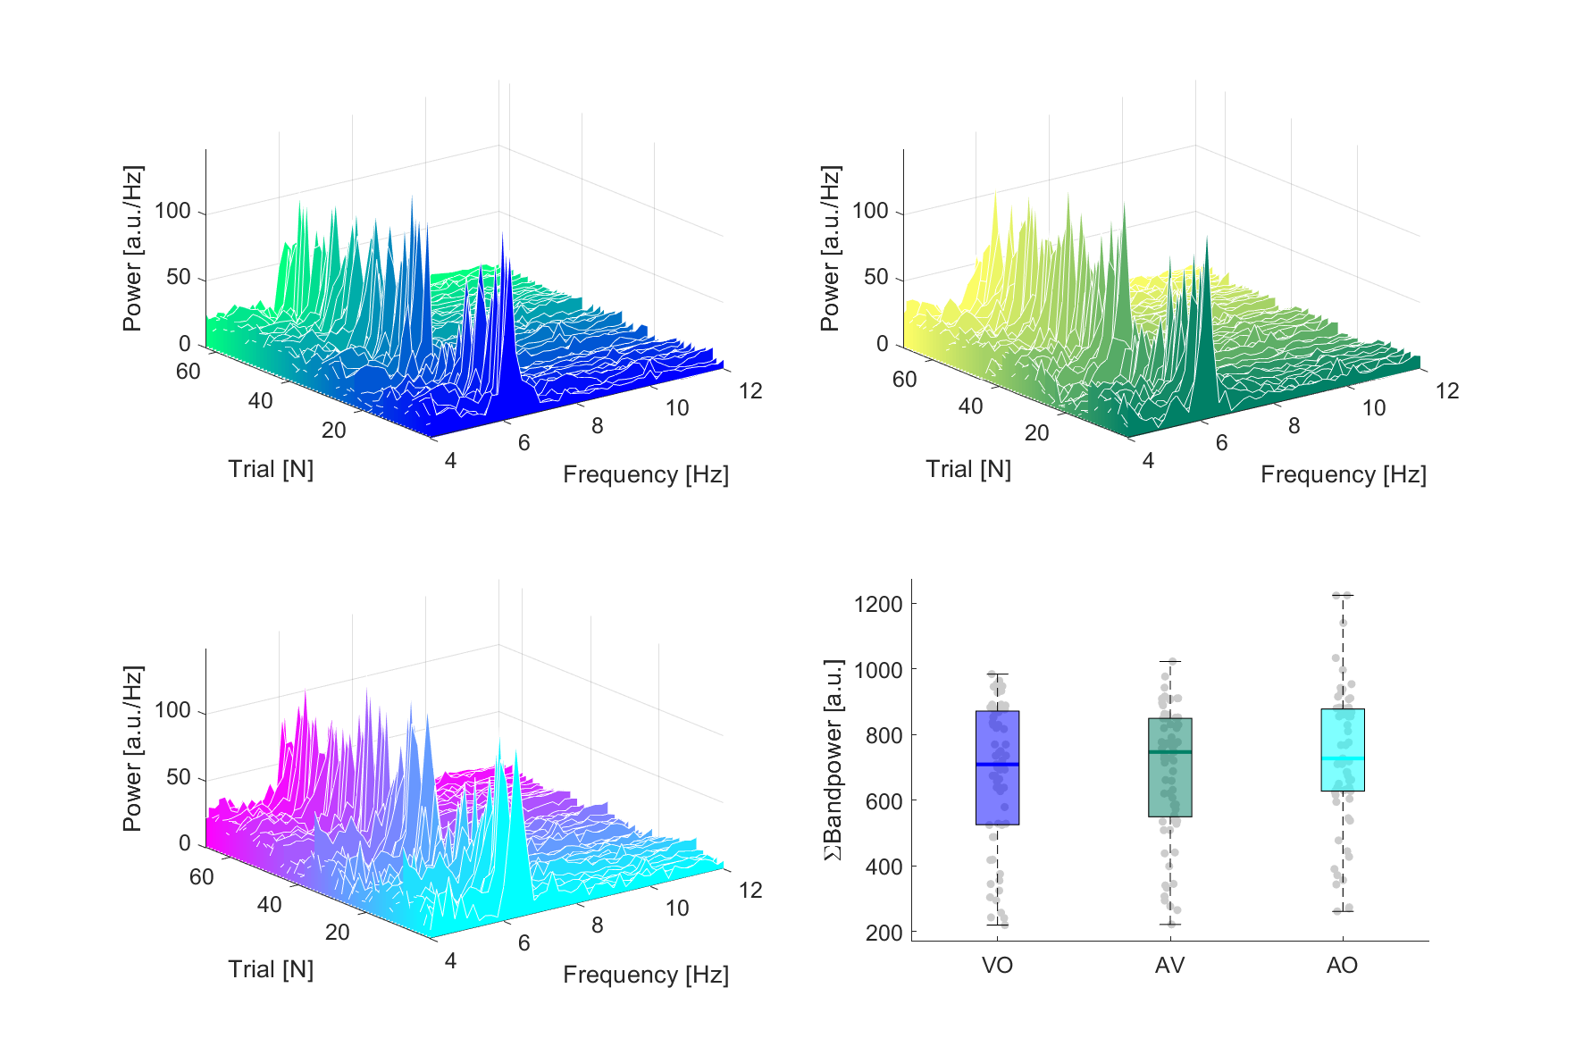
p119

Slide 17
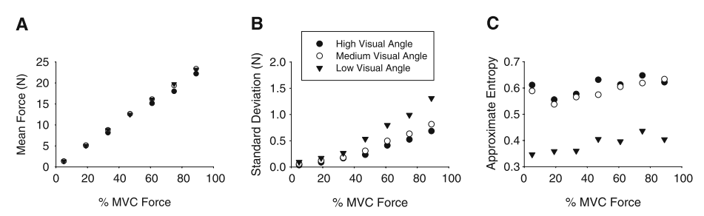
3 Experiments – visual gain
How the visual angle affected force variability across a range of target force levels. (high; (38°), medium (4.4°), and low (0.1°)

Slide 18
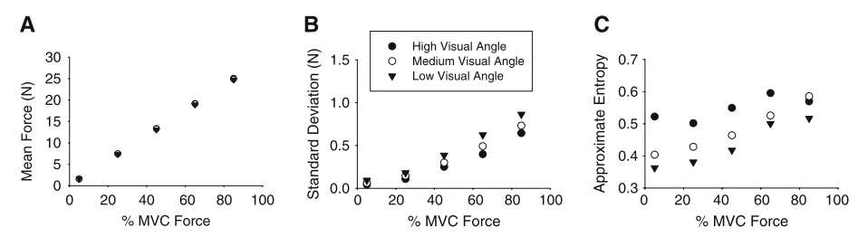
Monitor distance
How the visual angle affected force variability across a range of target force levels (Monitor distance)

Slide 19
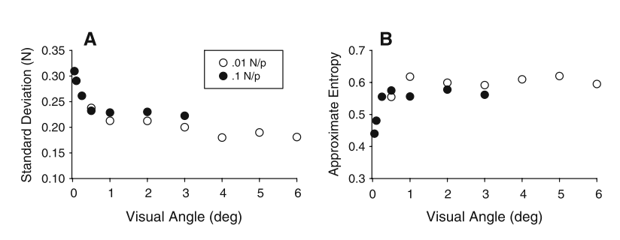
Combinations – 25% MVC
Force variability at two separate gain levels across the same visual angles in order to determine if the key informational variable was visual angle, gain, distance, or some combination of the three
Notes:
The two gain levels 0.1 and 0.01 (N/P ratio)
There were seven visual angle levels at the 0.1 gain level and seven visual angle levels at the 0.01 gain level

Slide 20
Archer
“[…] We chose visual gain levels below (0.039°) and above (6.9°) 0.5° […]”
0.074 cm & 13.31 cm

Slide 21
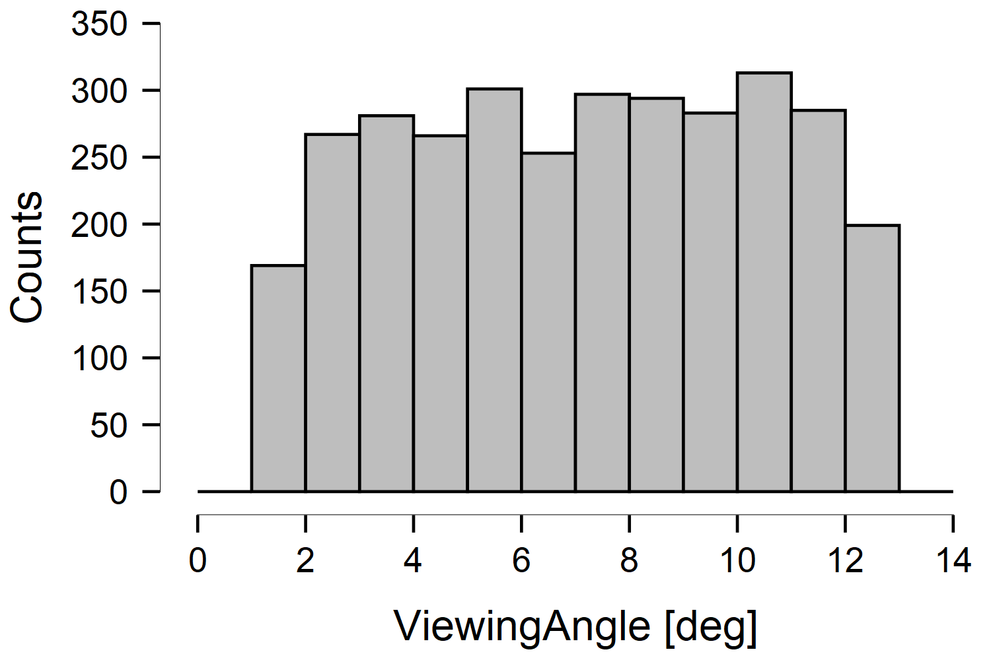
Next steps
0.039°
6.9°

Slide 22
Visual angle
0.039°
6.9°

Slide 23
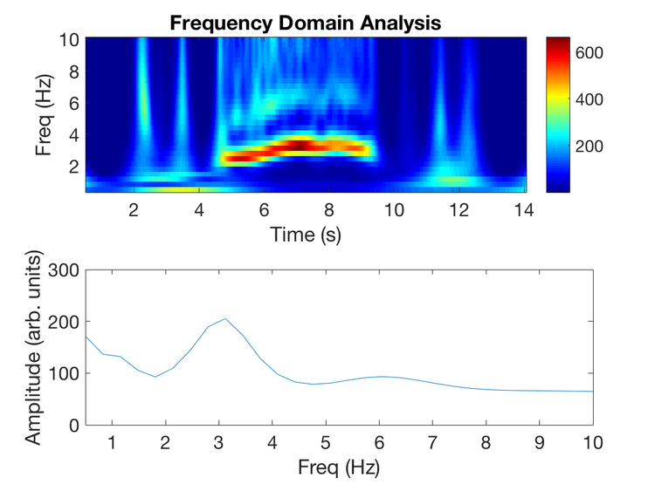

Tremor parameters
MVC vs. Power
Peak frequencies
Time variability
…
https://github.com/mattgaidica/MoveAlgorithms

Slide 24
New datasets
August 2021

Slide 25
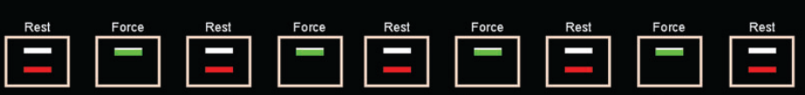
New paradigm
270 s total
5 rest periods (30s)
4 force periods (30s)
3 times for each feedback condition
15% of max force as target force
0.039°
6.9°

Slide 26
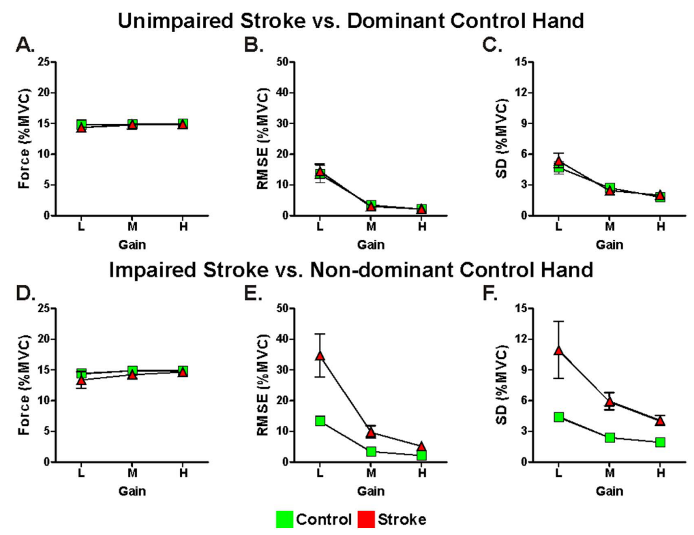
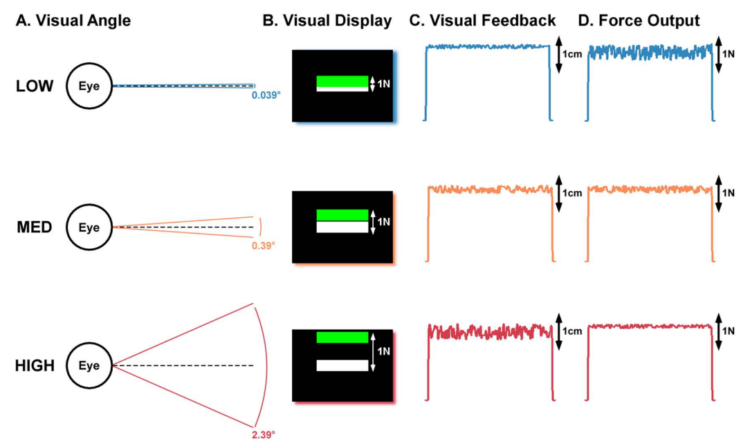
Visual feedback alters force control and functional activity in the visuomotor network after stroke
Archer ea., 2018

Slide 27
Supplementary Dirkx ea.
Supplement 3 – Pupil diameter versus luminance
We investigated the relationship between pupil diameter and luminance during the various trials by calculating the average pixel intensity per trial. Specifically, we used matlab to load 32bit screenshots of each trial which revealed the RGB values for every pixel ([0 0 0] representing a black pixel and [255 255 255] a white). This showed that the average pixel value was slightly larger for the rest trials compared to any of the cognitive load trial (supplementary table 2). However, there was no relationship between the average pixel value and pupil diameter for each cognitive load trial (supplementary figure 2A), nor was there a significant correlation between the relative increase in pupil diameter (cognitive load minus the preceding rest trial) and relative decrease in pixel intensity (supplementary figure 2B). If anything, pupil diameter increased more for cognitive load trials that showed little difference in pixel intensity compared to the rest trial (supplementary figure 2B), emphasizing that these effect are unrelated to luminance.

